Slide 1
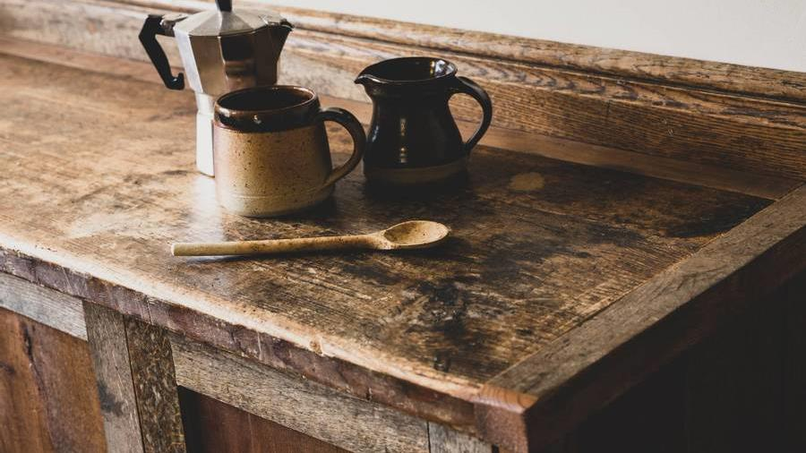
Bright coffee shop
Analysis of sales
Itumeleng Thothobolo

Slide 2


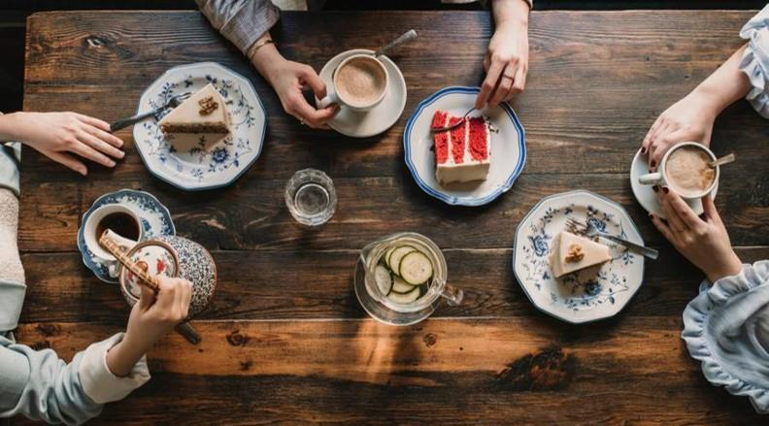
Agenda
Analysis of sales
Trends
Location sales
Topic four

Slide 3

Introduction
Breaking down the trends to see the best selling products, at which location and trying to close all the loopholes by checking where we can improve and how can we improve our sales,

Slide 4
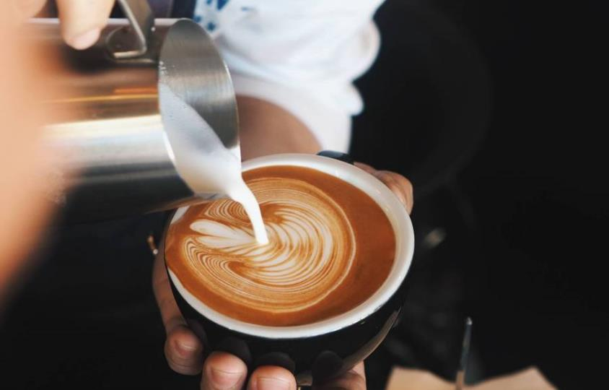

$689 812,33
Total sales from January to June

Slide 5
Chart

Slide 6
Sales by time split and location
Best selling times
Best selling location

Slide 7
Additional content
Mid-morning sales 32%
Morning and afternoon 24%
Peak afternoon rush
Most sales happened between 9am-12am
From morning sales and also between 12am-4pm sales shows a percentage of 24
Shows a decline in sales between afternoon and evening

Slide 8

Baristo espresso is the most sold product.

Slide 9

Reccommendations
Consider opening more stores where there is a lot of movement from people
Stocking up the most sold products, top 5
Consider drinks for spring and summer e.g iced coffee
Create light meals to go with the coffee too

Slide 10



Thank you
Thothobolo Itumeleng
itumelengshirley9@gmail.com

